Slide 1
Demonstration of types of viruses and its mechanism
IT
Group 07

Slide 2
Contents
1. Introduction
2. Diagrams
3. OOP Techniques
4. Member’s contribution

Slide 3
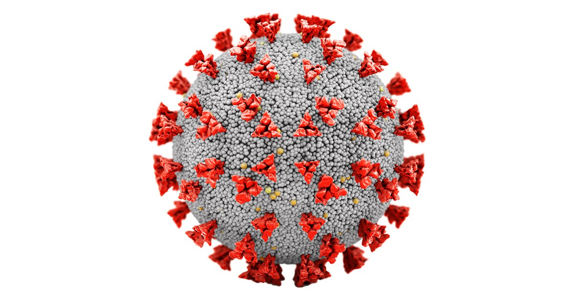
Introduction
In a world where viruses continuously threaten global health, it has become more crucial than ever to comprehend their diverse forms and the methods they employ to infect host cells. With the ongoing spread of COVID-19 serving as a stark reminder of the impact viruses can have on humanity, there is an urgent need for education and awareness.

Slide 4
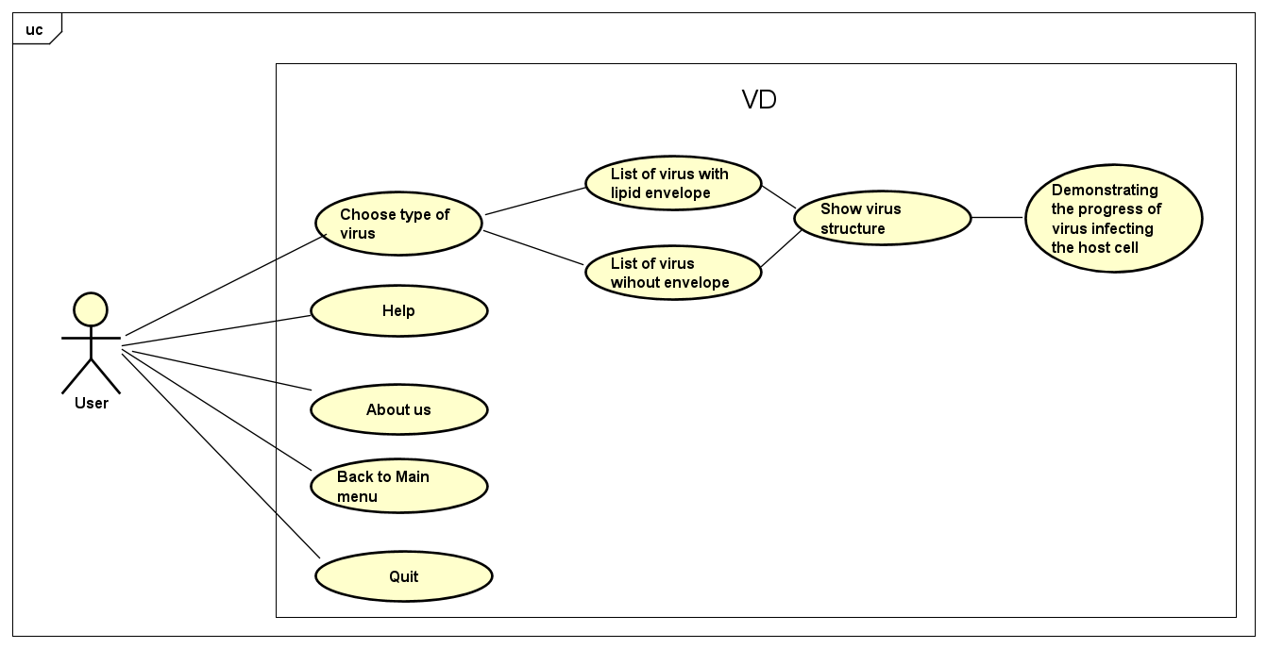
Use Case Diagram

Slide 5
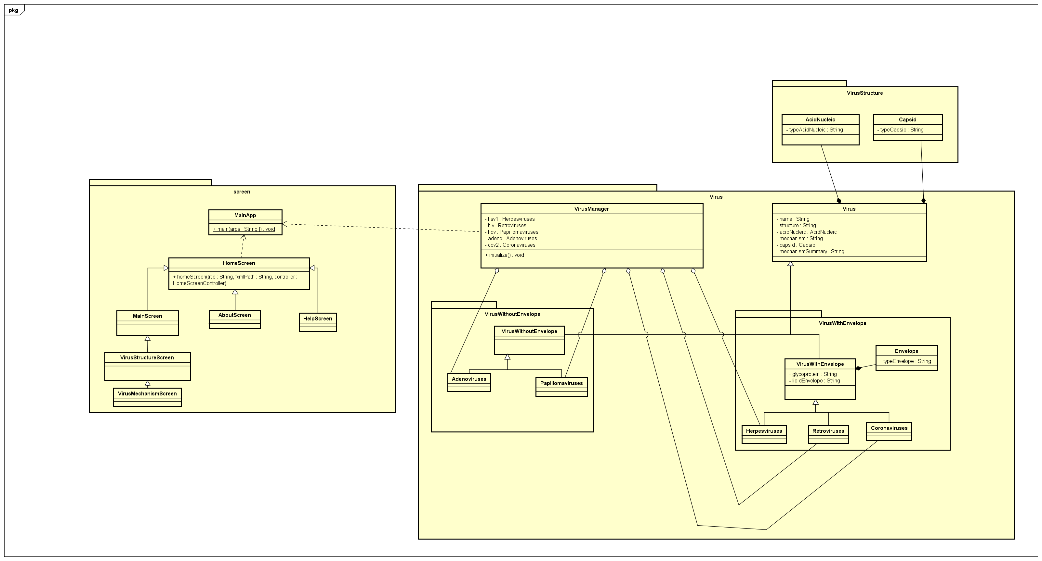
General Class Diagram

Slide 6
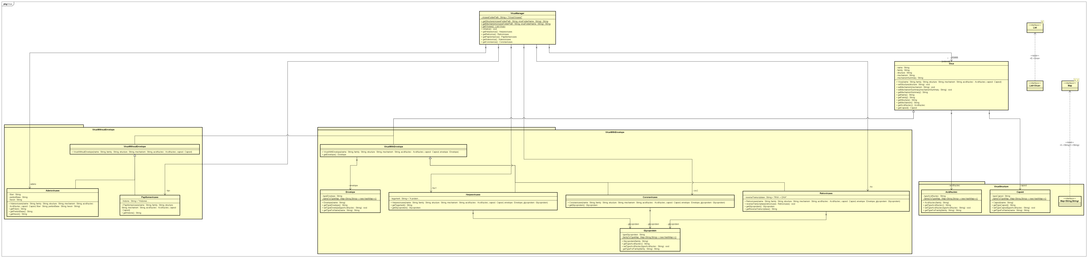
Detailed Class Diagram

Slide 7
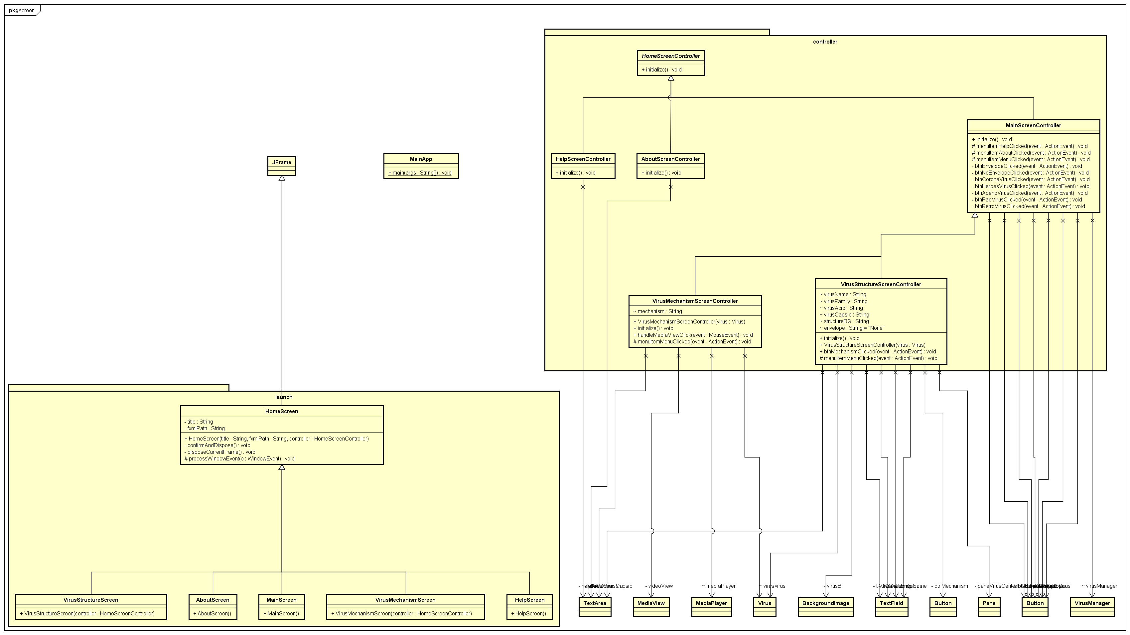
Detailed Class Diagram

Slide 8
OOP Techniques

Slide 9
Member’s Contribution

Slide 10
Thank you for listening!

